Slide 1



High Strain Fatigue Characteristics of Magnetic Shape Memory Alloys
Presented by: Nicholas S. Garcia
Mentor: Dr. Constantin Ciocanel
Northern Arizona University
Mechanical Engineering

Slide 2
What are Magnetic Shape Memory Alloys (MSMA)?
A class of smart materials that:
Exhibit the shape memory effect in the presence of a magnetic field
Exhibit a magnetic field induced reorientation strain as large as 10%
Can be used in actuation, sensing, and power harvesting applications

Slide 3
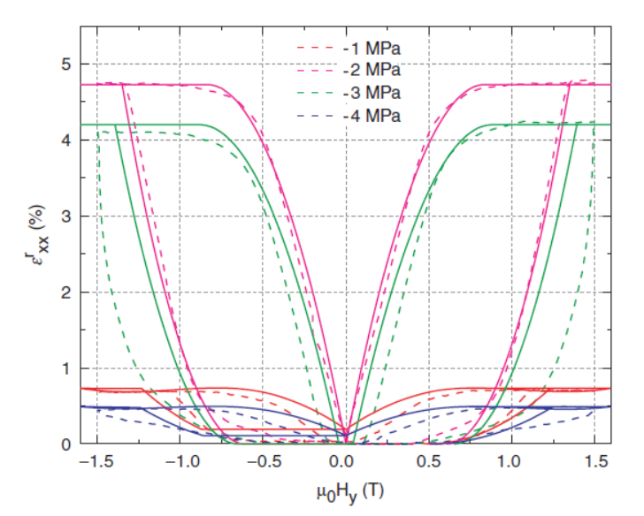
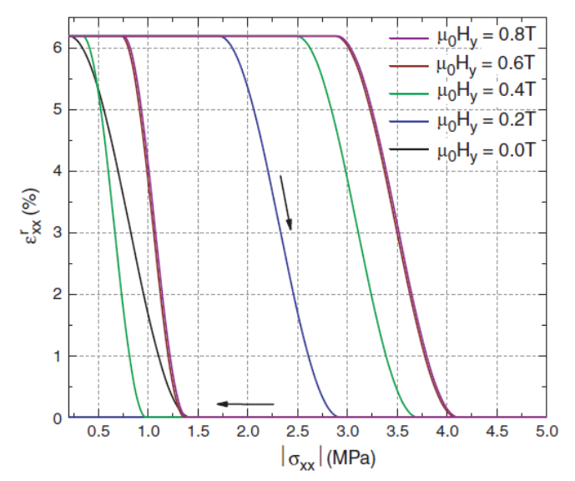
Magneto-mechanical response of MSMAs
B. Kiefer and D. C. Lagoudas, Journal of Intelligent Material Systems and Structures, 20 , 143 – 170, 2009
Actuation
Sensing/power harvesting

Slide 4
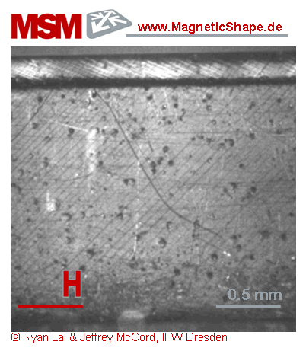
Why research the fatigue behavior of MSMAs?
In applications MSMAs complete a large number of magneto-mechanical cycles.
The variant reorientation, over time, yields to crack nucleation and growth in the material.
Ni₅₀Mn_{28.5}Ga_{21.5}
Stress
Notes:
These cycles are associated with internal martensite variants being reoriented

Slide 5
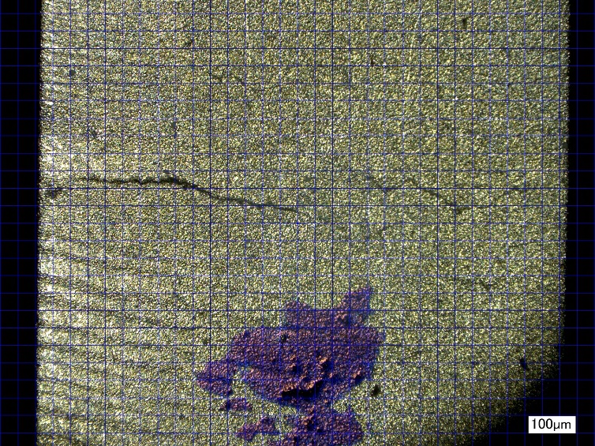
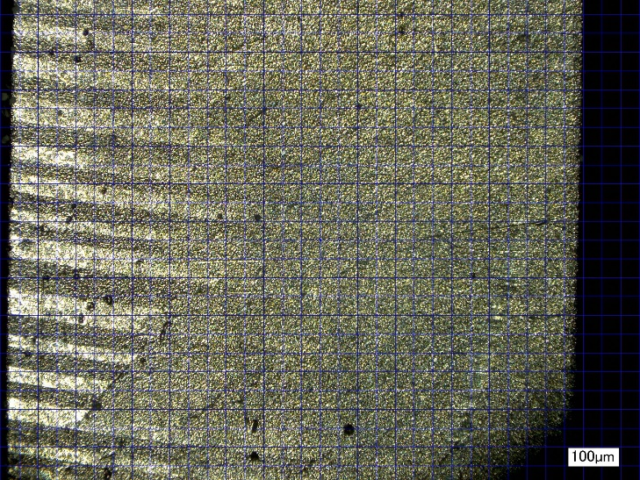
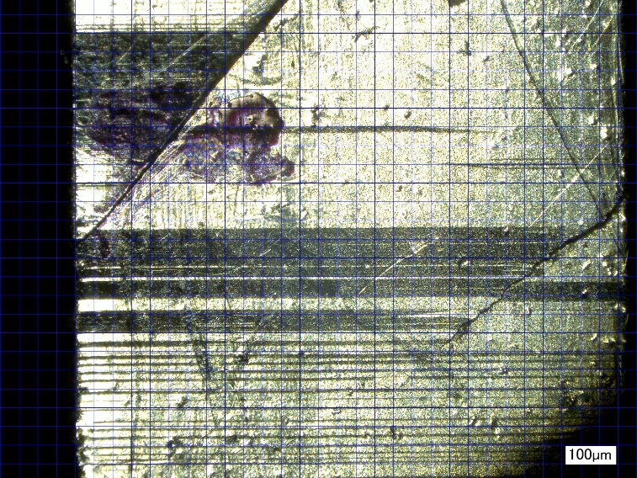
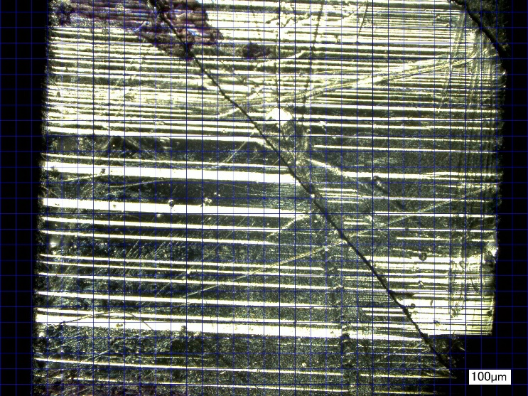
MSMA fatigue failures

Slide 6
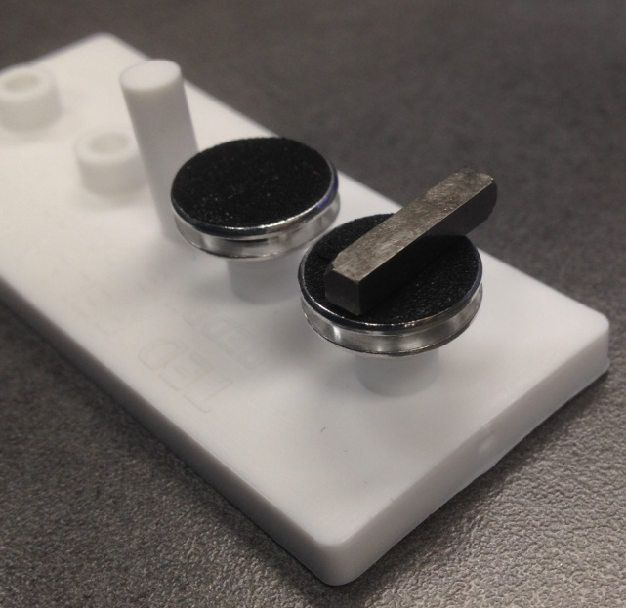
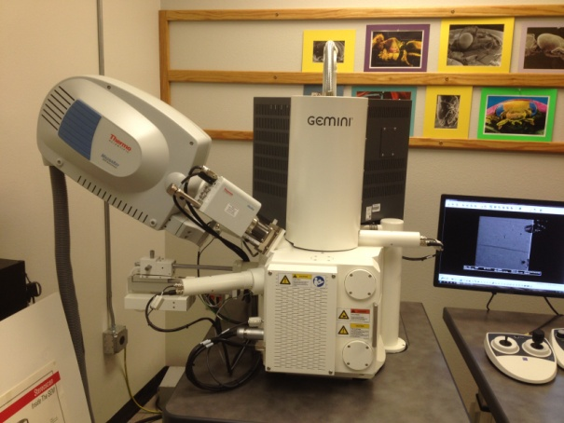
Research
Characterize the fatigue life in cyclic loading
Strain the material between 3 and 6% reorientation strain until failure occurs
Main failure mode: crack nucleation and growth
Zeiss Supra 40VP
Scanning Electron Microscope
MSMA sample on stub

Slide 7
Approach
New specimens are imaged to identify possible existing defects.
Specimens are then fatigued, in either actuation or power harvesting loading modes.
At predetermined number of cycles, the specimens are removed from the test fixture and reimaged to identify whether new cracks nucleated on the specimen.

Slide 8
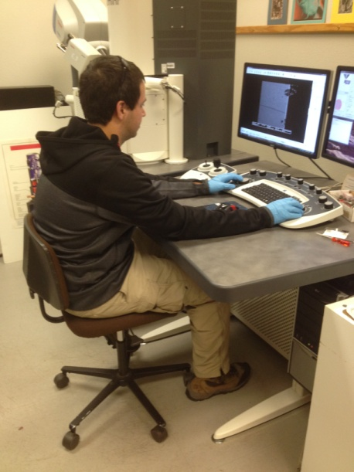
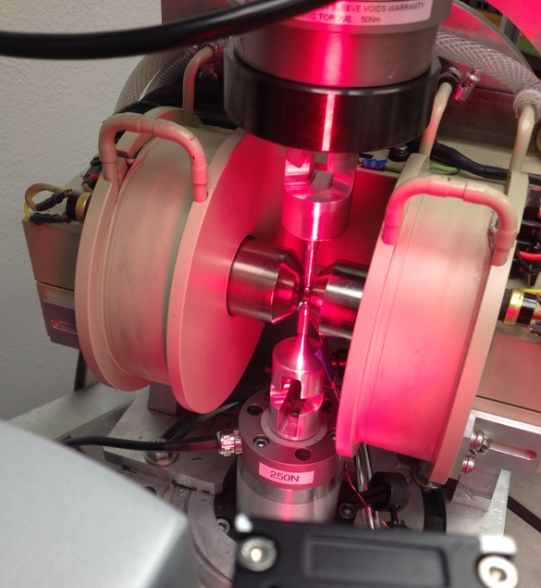
Approach (contd)
If new cracks nucleated, their size will be measured and monitor their growth with the number of cycles.
Special attention will be given to the sites where cracks nucleate and to the directions along which cracks grow.
Sample imaging on the SEM
MSMA sample in test apparatus

Slide 9
Results to date
Twin Variants
SEM Image
Surface Mapping of Sample With Grid
Digital Microscope
Surface imperfection
SEM Image

Slide 10
Future
Characterize samples to obtain calibration curves (in progress)
Cycle specimens to failure
Develop S-N curve from data

Slide 11
Acknowledgements
Arizona Space Grant Consortium
Dr. Nadine Barlow & Kathleen Stigmon
Dr. Constantin Ciocanel
Perry Wood, Isaac Nelson, Aubrey Funke

Slide 12
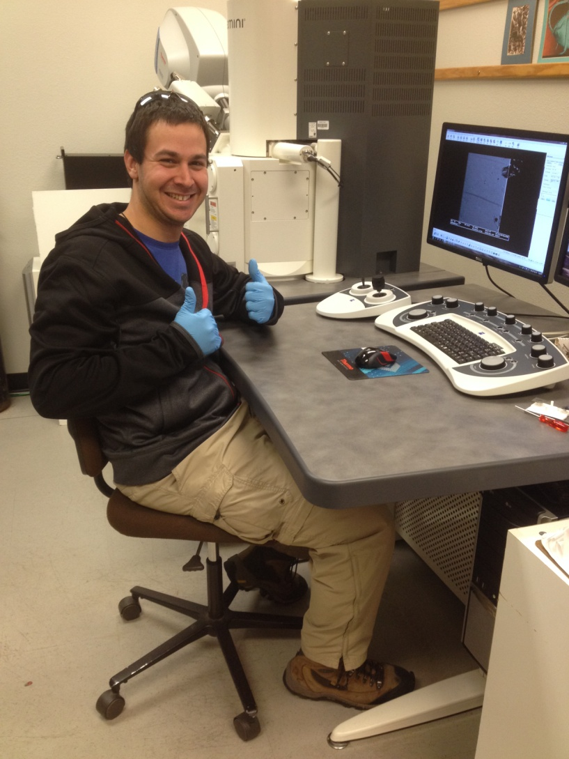
Questions?

